Slide 1


Parallel and Distributed Systems / 2
Pavel Krömer, Dept. of Computer Science, VSB – Technical University of Ostrava

Slide 2
Agenda
Major topics
Types, basic concepts, classification
Literature
Bhujade Moreshwar R., M.R. Bhujade; Parallel Computing, New Age International, 2009
Mattson, Timothy G., Rasmussen, Craig E., Sottile, Matthew J; Introduction to Concurrency in Programming Languages, Chapman & Hall/CRC Press, 2009
David Padua; Encyclopedia of Parallel Computing, Springer US, 2011

Slide 3
Parallel platforms and programs
Notes:
what do we associate with digital transformation/DSM?
Is that all new? Is this change the first?

Slide 4
Motivation
The main purpose of a classification/taxonomy is to provide a common language in which parallel and distributed architectures can be discussed.
(cw. {design | integration | architectural} patterns)
Caveats
not a single classification agreed upon
age quickly

Slide 5
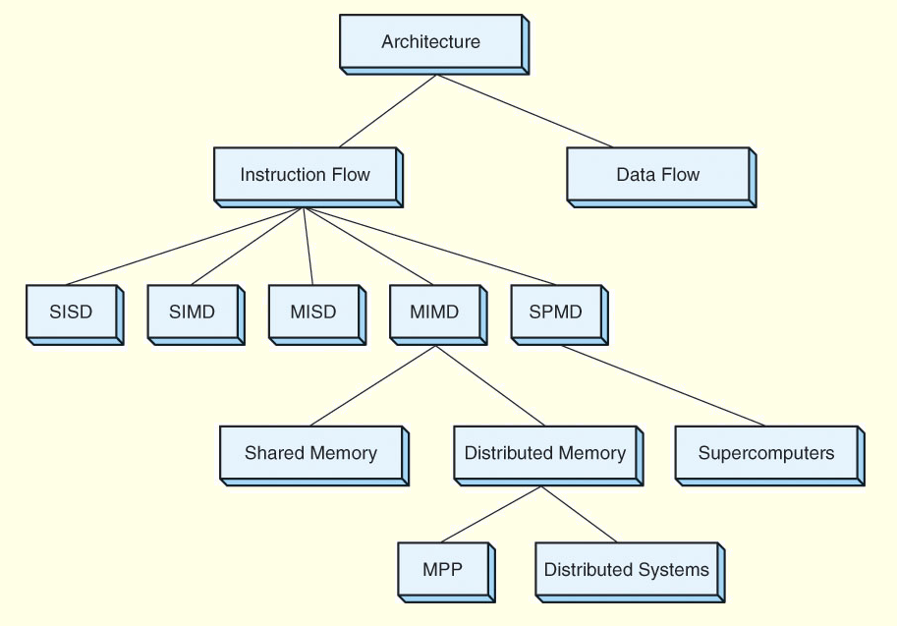

Slide 6
Flynn’s 1967 taxonomy
Flynn, Michael. (1967). Very High-Speed Computing Systems. Proceedings of the IEEE. 54. 1901 - 1909. 10.1109/PROC.1966.5273.
Dimensions: instruction and data streams

Slide 7
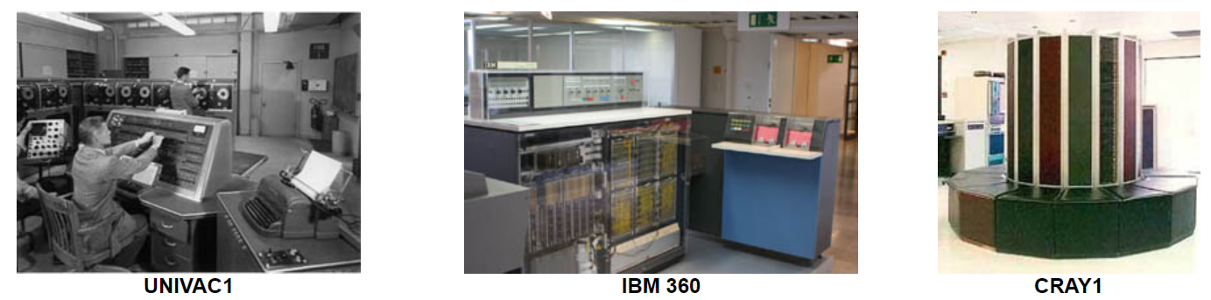
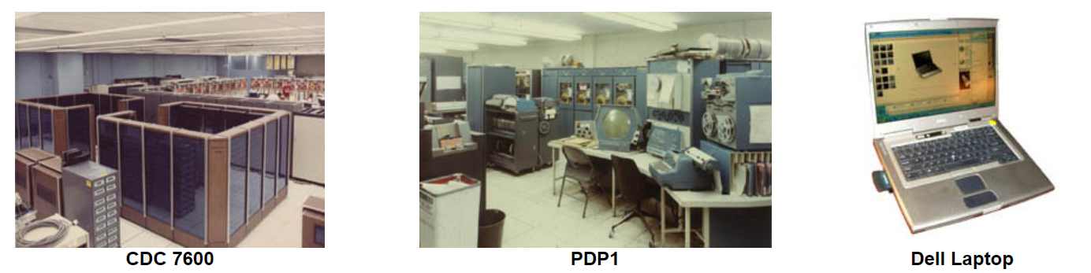
Single-instruction single-data
SISD
Serial (non-parallel) computer
‘Von Neumann architecture*’, deterministic execution
Only one instruction stream executed by the CPU
Only one data stream used as an input during any clock cycle

Slide 8
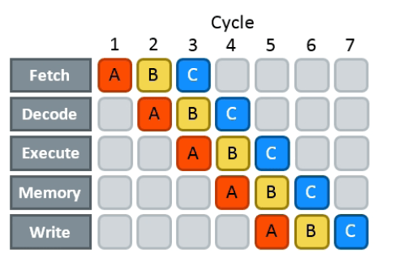
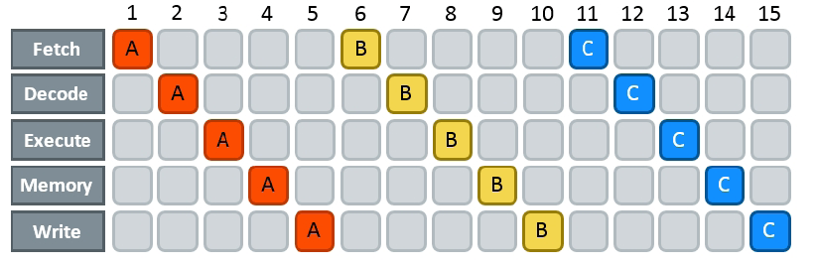
Single-instruction single-data
SISD
Parallel extensions of SISD architectures
Instruction pipelining

Slide 9
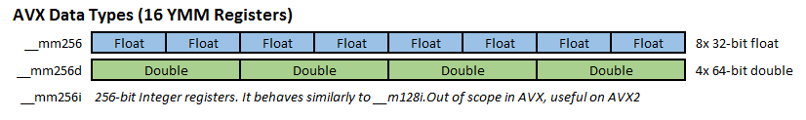
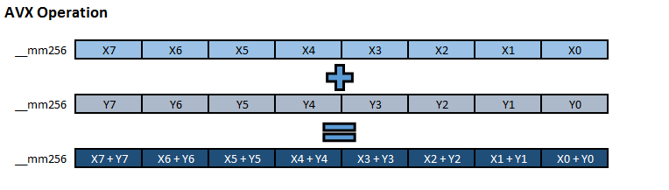
Single-instruction single-data
SISD
Parallel extensions of SISD architectures
Vector registers, extended instruction sets
Same instructions applied to a vector of data
MMX (1997, 80-bit), SSE (128-bit), AVX (2011, 256-bit), AVX-512 (2016)

Slide 10
Single-instruction single-data
SISD
Parallel extensions of SISD architectures
Superscalar execution
multiple instruction pipelines
in-order execution
Very-long instruction word (VLIW);
One instruction encodes more operations (for each pipeline one)
Compiler finds instructions that can be speculatively executed in parallel
out-of-order execution
Hardware finds independent instructions

Slide 11
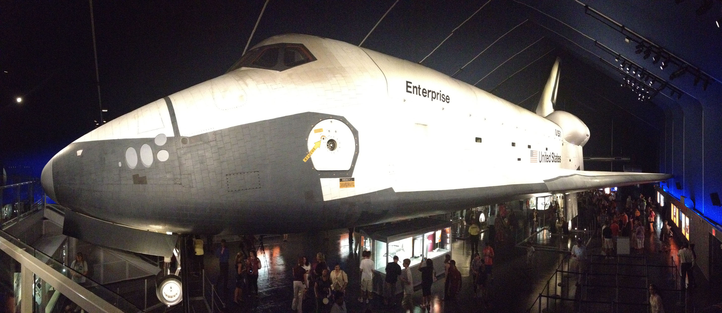
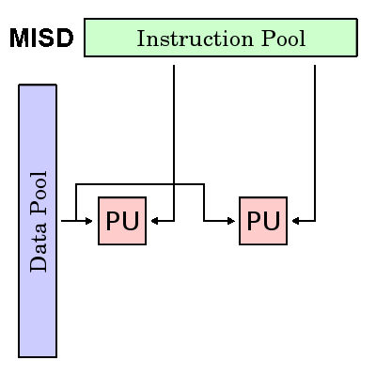
Multiple-instruction single-data
MISD
Rather rare parallel architecture
Each processing unit operates on the data independently via separate instruction streams
A single data stream is fed into multiple processing units
Example usage
Redundant execution for fault tolerance (Space Shuttle flight control, Falcon 9/heavy avionics - “flight strings”)
Multiple frequency filters operating on a single signal stream
Multiple cryptography algorithms attempting to crack a single coded message

Slide 12
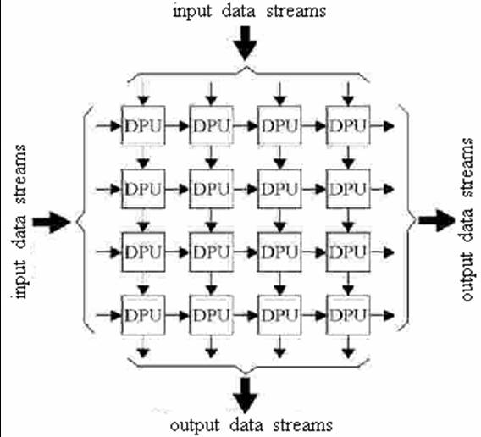
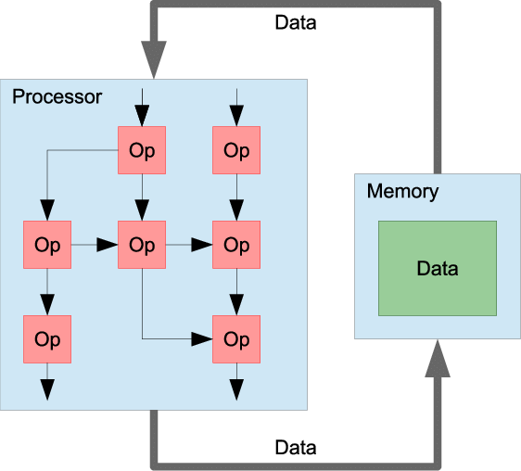
Multiple-instruction single-data
MISD
Modern MISD-like architectures
Systolic arrays
Computational networks with distributed data storage and distributed processing units
Matrix operations, convolution
Use: FPGAs, ASICs
Data-flow computers
operations executed when their operands are available
Maxeler Technologies

Slide 13
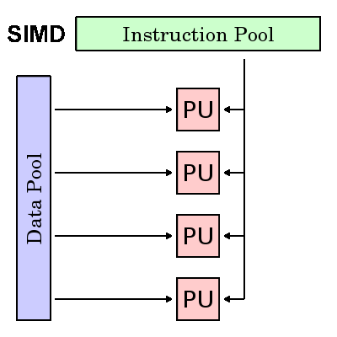
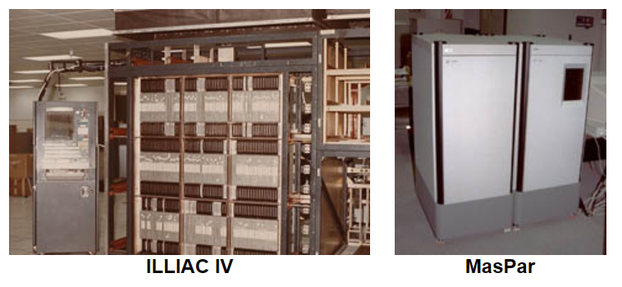
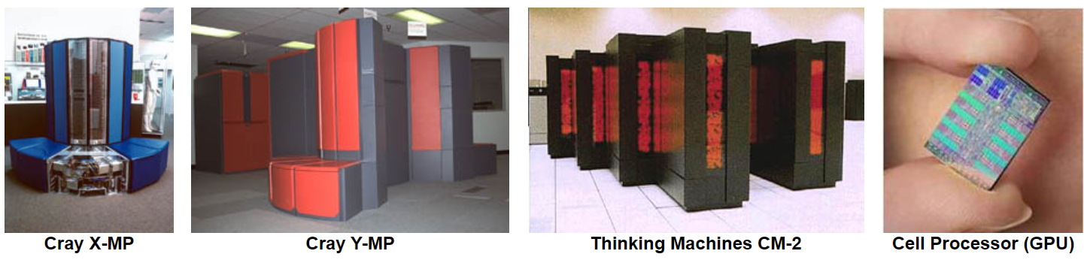
Single-instruction multiple-data
SIMD
AKA: data-parallelism, vector operations
All processing units execute the same instruction at any given clock cycle
Each processing unit can operate on a different data element
Good for specialized problems with a high degree of regularity,
Matrix ops, graphics/image processing.
Synchronous (lockstep) and deterministic execution

Slide 14
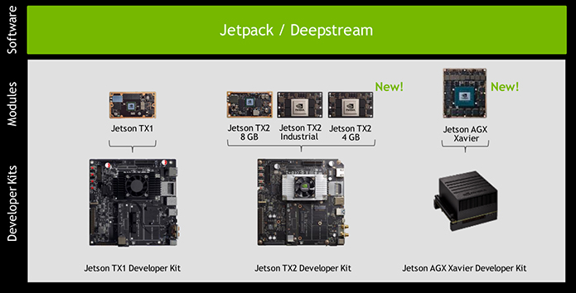

Single-instruction multiple-data
SIMD
Modern examples
GPGPUs, FP accelerators
CPUs

Slide 15
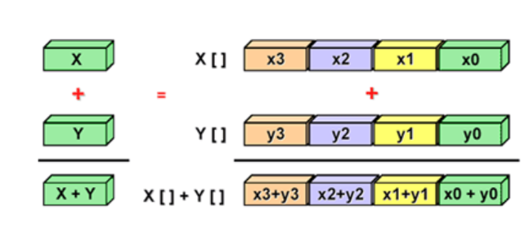
Single-instruction multiple-data
SIMD
A SIMD computation
Caveat
branching

Slide 16
Multiple-instruction multiple-data
MIMD
General parallel (task parallel) computation without the restrictions of SIMD

Slide 17
Beyond Flynn’s taxonomy
Extensions and alternatives
SPMD - Single process multiple data
MPMD - Multiple process multiple data
Multiple SIMD - hybrid architectures of multiple SIMD systems
Superscalar SIMD
Feng’s classification (1972)
serial vs parallel processing
Handler’s classification (1977)
based on the degree of parallelism/pipelining ability of computer subsystems

Slide 18
Beyond Flynn’s taxonomy
Feng’s classification
Vocabulary
System classification
Word Serial and Bit Serial (WSBS)
Word Parallel and Bit Serial (WPBS)
Word Serial and Bit Parallel(WSBP)
Word Parallel and Bit Parallel (WPBP)
WSBS has been called bit parallel processing because one bit is processed at a time.
WPBS has been called bit slice processing because m-bit slice is processes at a time.
WSBP is found in most existing computers and has been called as Word Slice processing because one word of n bit processed at a time.
WPBP is known as fully parallelprocessing in which an array on n x m bits is processes at one time.

Slide 19
Beyond Flynn’s taxonomy
Handler’s classification
Evaluates 3 levels of systems architecture
processor control unit (PCU [= CPU]); Arithmetic logic unit (ALU); Bit-level circuit (BLC)
Computer = (p * p', a * a', b * b’)
p = number of PCUs
p'= number of PCUs that can be pipelined
a = number of ALUs controlled by each PCU
a'= number of ALUs that can be pipelined
b = number of bits in ALU or processing element (PE) word
b'= number of pipeline segments on all ALUs or in a single PE
set of well-defined operators (*,+,v,~)
Example: Cray-1 = (1, 12 * 8, 64 * (1 ~ 14))

Slide 20
Memory organization in parallel environments
Notes:
what do we associate with digital transformation/DSM?
Is that all new? Is this change the first?

Slide 22
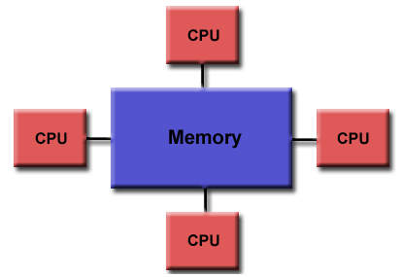
Shared memory systems
Processors have access to the complete memory (as a global [shared] address space)
Processors can operate independently but share memory resources
Changes in memory caused by one processor are visible to all other
Also tightly coupled systems

Slide 23
Shared memory systems
Uniform memory access (UMA)
AKA Symmetric Multiprocessors (SMPs)
Systems of identical processors with equal access and access times to memory
Sometimes called Cache Coherent UMA (CC-UMA)
if one processor updates a location in shared memory, all the other processors know about the update
cache memories that provide access to these variables are kept consistent
accomplished at the hardware level (snoopy/sniffy bus protocol)

Slide 24
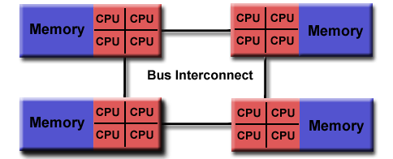
Shared memory systems
Non-uniform memory access (NUMA)
One SMP can directly access memory of another SMP
Not all processors have equal access time to all memories
Memory access across link is slower
Cache Coherent NUMA (CC-NUMA) if cache coherency is achieved

Slide 25
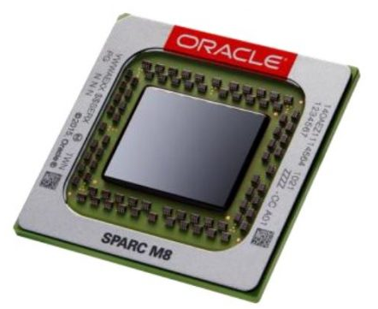
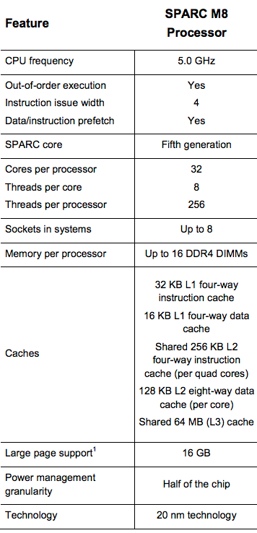
Shared memory systems
Pros and cons
Advantages
Global address space provides a user-friendly programming access to memory
Data sharing between tasks is both fast and uniform due to the proximity of memory to CPUs
Disadvantages
Lack of scalability between memory and CPUs. Adding more CPUs can geometrically increases traffic on the shared memory-CPU path, and for cache coherent systems, geometrically increase traffic associated with cache/memory management
Programmer responsibility for synchronization constructs that ensure "correct" access of global memory.

Slide 26
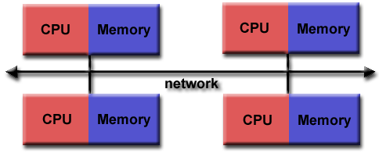
Distributed memory systems
Use a communication network to connect inter-processor memory.
Processors have own local memory and memory addresses in one processor do not map to another processor. No global address space exists.
Processors operate independently, local changes do not affect other processors (and their memory). Cache coherency out of question.
IPC (data sharing + synchronization) explicitly defined by program/programmer.
Also loosely coupled systems

Slide 27
Distributed memory systems
Challenging IPC
Explicit IPC via message passing
Communication usually a significant bottleneck
Communication-driven algorithm design and considerations
Advantages
Memory scalable with the number of processors
Each processor can rapidly access its own memory without interference and without any special overhead wrt. cache coherency
Cost effective, can use commodity, off-the-shelf processors and networking

Slide 28
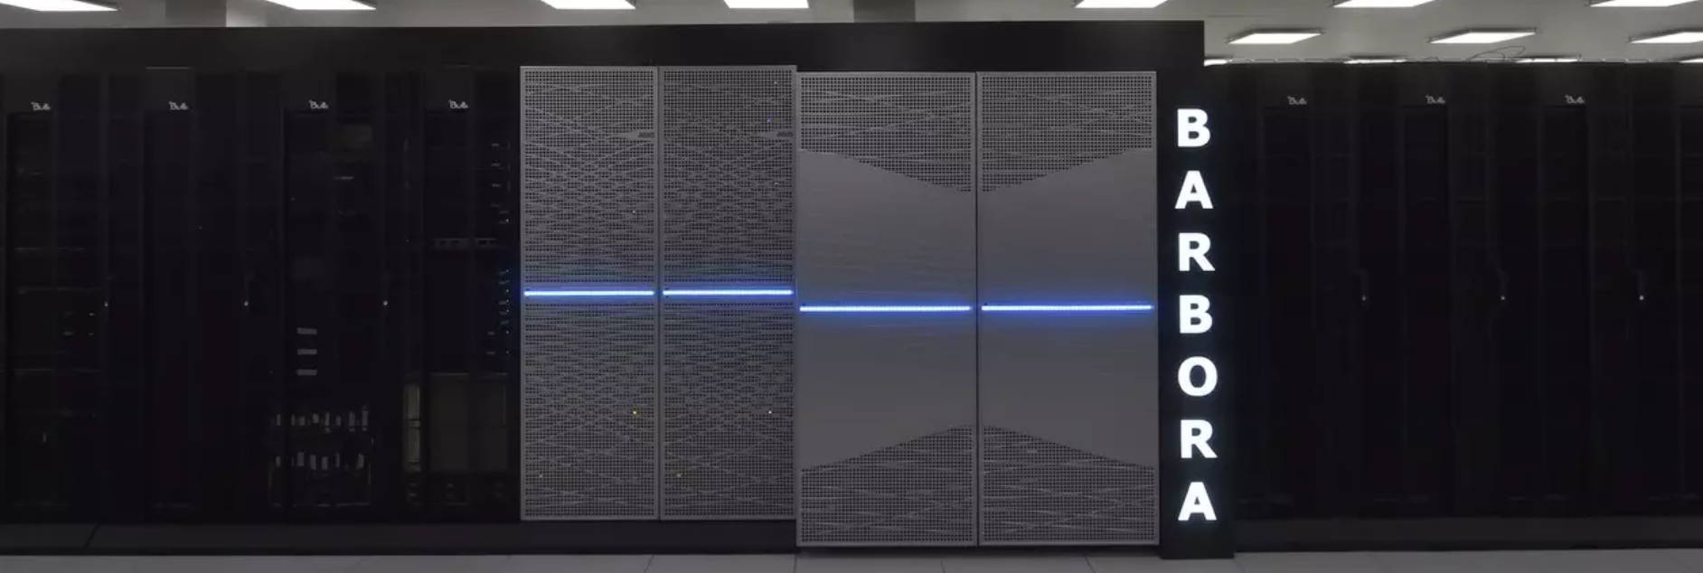
Distributed memory systems
Disadvantages
Program/programmer responsible for all details associated with data communication between processors
Difficult mapping of existing data structures to distributed memory for an efficient execution
Non-uniform memory access times - data residing on a remote node takes longer to access than local data
Barbora - 2. 10. 2019, VSB-TUO / IT4Innovations - 192x compute node w. 18-core CPU, 192 GiB RAM
- 8x GPU node w. 12-core CPU, 192 GiB RAM, 4x NVIDIA V100
- 1x fat node w. 8x16-core CPU, 6 TiB RAM

Slide 29
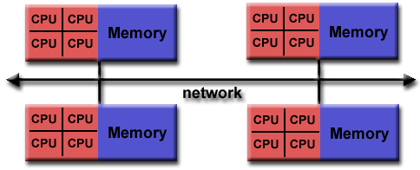
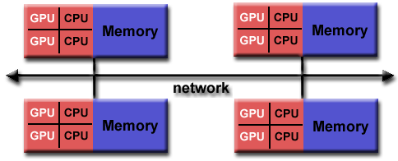
Hybrid systems
Real-world systems combine SMPs and distributed memory
Combine the advantages/disadvantages of both
Increased scalability traded for increased program complexity

Slide 30
Alternative classifications
Notes:
what do we associate with digital transformation/DSM?
Is that all new? Is this change the first?

Slide 31
System description can be based on
Parallelism type
Data vs. task parallelism
Granularity
The ratio of communication and computation
How many instructions in a process*
Fine (<20) vs. medium (<500) vs. coarse grained programs
Degree of parallelism
high vs. low

Slide 32
Final thoughts
Notes:
what do we associate with digital transformation/DSM?
Is that all new? Is this change the first?

Slide 33
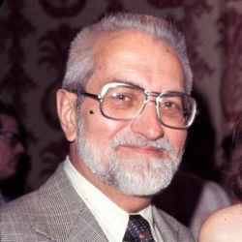
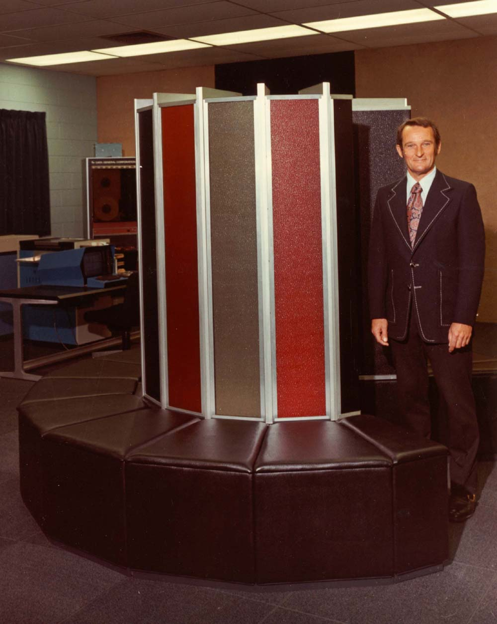
Herb Grosch’s law and Seymour Cray’s observation
Computers should obey a square law — when the price doubles, you should get at least four times as much speed.
I said that in 1963!
1965: … to do a calculation 10 times as cheaply you must do it 100 times as fast.
I call it Grosch's law.

Slide 34
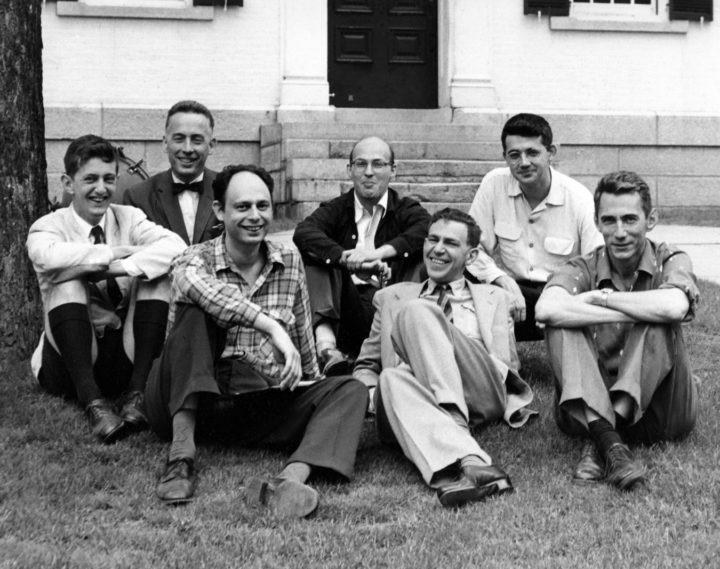
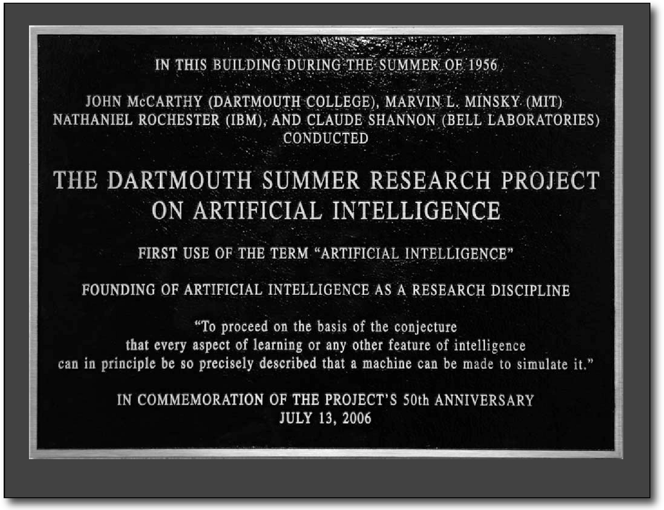
Marvin Minsky’s conjecture
John McCarthy
Oliver Selfridge
Marvin Minsky
Ray Solomonoff
Claude Shannon
1970: For a parallel computer with n processors, the speedup S shall be proportional to log₂(n)
Notes:
Selfridge
early papers on neural networks and pattern recognition and machine learning; famous for the pandemonium architecture (computational model of pattern recognition)
his ideas gave rise to aspect-oriented programming.
Solomonoff
author of algorithmic probability, contributor to Kolmogorov complexity, algorithmic information theory
Minsky
co-founder of MIT AI lab, inventor of head-mounted display (1963), confocal microscope, designer of a 7,4 Turing machine (1962, best known until 2002)
Famous for ‘Perceptrons,’an attack on Rosenblatt’s wokt in ANN and one of the (possible) causes of 1970’s AI Winter
McCarthy
author of AI (the phrase, really), designer of LISP, concept of garbage collection, time-sharing systems (early perception of cloud computing)
Shannon
- information theory, entropy (from that, natural language processing, computational linguistics)

Slide 35

Gene Amdahl’s law

Slide 36
What that means ?!
Grosch speaks about the economy of IT
Grosch's Law appears to be a result of marketing policy more than of manufacturing expenses
At some point of time, manufacturers priced their computers according to it
Amdahl's law was a strong argument against parallel computers
The development of parallel algorithms would be too inefficient if it held
Experimentally proven wrong [Sandia lab, 40-80% serial and scales linear]
Minsky’s conjecture was based on technology of 60’s and 70’s
Technologies like DMA and multitasking made it obsolete
Can be still seen as worst-case scenario

Slide 37

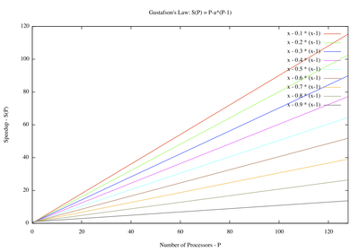
John Gustafsons’s law

Slide 38
What that means (II) ?!
Gustafson overcomes the fixed problem size assumption by Amdahl
Problems usually do not have fixed size
Size of problems set to fully exploit the computing power
Parallelism seen as an opportunity to solve larger-scale problems
My favourite example: boot/load time

